Slide 1



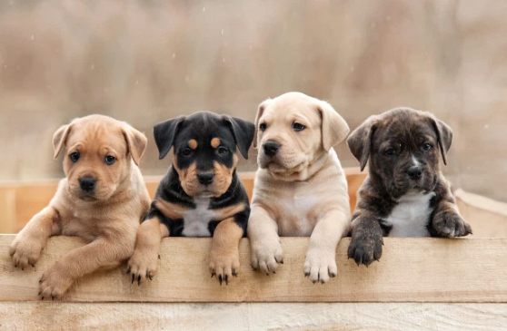
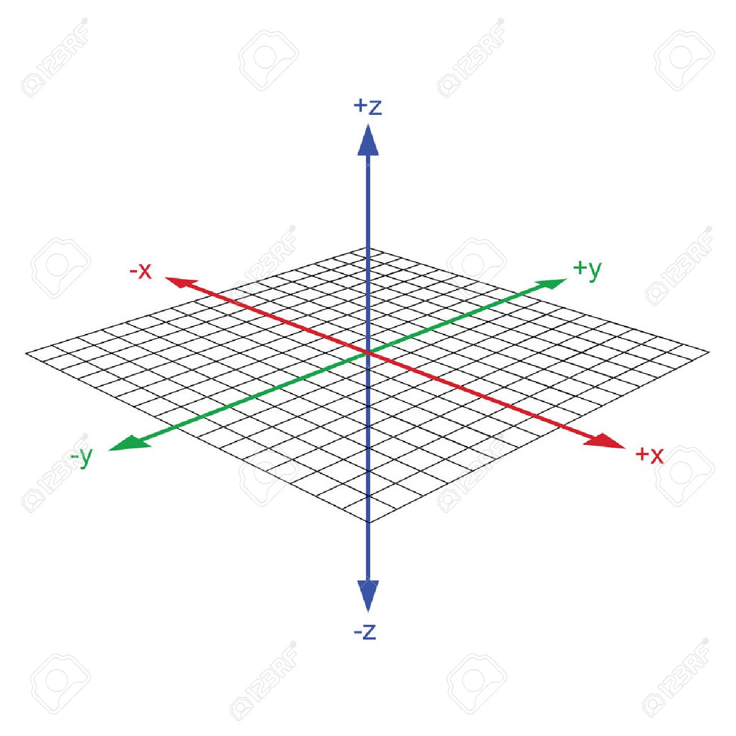
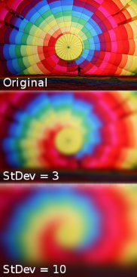





M
A
I
N
D
E
V
I
C
E
Color conversion
[영상처리 라이브러리]
Get Image
Removal
Background
conversion Image
Find Dog Object
Check Object Coordinate
Image Blurring
[영상처리 라이브러리]
Don’t Find
Dog Object
Change the
Image Coordinate
Camera Tile
Receive the Coordinate
Change The
Tile Machine
Focus On
Dog Image

Slide 2


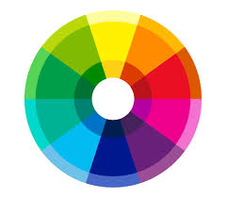


S
U
B
D
E
V
I
C
E
If it is not White
Color Average
Color conversion
[영상처리 라이브러리]
White Color
Get Image
Removal
Background
conversion Image
Set Range Image
Color comparison matching
Decision Dog
Bowel Movement
Image Blurring
[영상처리 라이브러리]
Learning Data
Comparison

